Slide 1

Sequences and Series

Slide 2
OBJECTIVES
Define sequences and identify the different kinds of
sequences.
Find the nth term or the general term of a sequence for
which some initial terms are given.
Find the common difference of an arithmetic sequence.
Find the common ratio of a geometric sequence.
Find arithmetic means, harmonic means and geometric
means.
Find the sum of a finite arithmetic sequence, harmonic
sequence and geometric sequence.
Find the sum of an infinite geometric sequence.

Slide 3
Definition:
SEQUENCE
A sequence or progression is a list of objects, events or numbers in a definite order of occurrence. Each member of a sequence is called a term. A sequence is said to be finite if it contains finite number of terms. An infinite sequence is one having infinite number of terms, thus, the last term is not indicated. The notation , a_{n}, represents the nth term or the general term of the sequence.
Example: The following represent a sequence:
2, 4, 6, 8
1, 5, 9, 13, 17, 21,…
1, 3, 9, 27, …

Slide 4
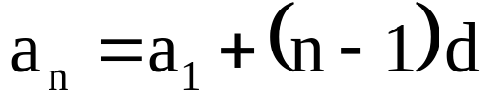
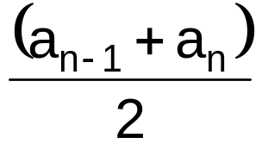

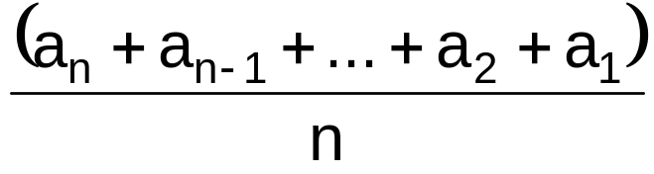
Definition:
ARITHMETIC SEQUENCE
An arithmetic sequence is a sequence in which the difference between two successive terms is constant. This difference , d, is called the common difference.
For any arithmetic sequence in which a_{n} is the general term, a₁
is the first term, and n is a positive integer.
The first and last terms of the sequence are called arithmetic extremes.
The terms in between are called arithmetic means.
The arithmetic mean between is defined by
The arithmetic mean of n terms is

Slide 5

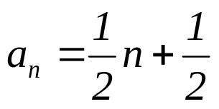
EXAMPLE:
Given the sequence 1, -4, -9, …, list the next three terms and write a
formula for the nth term .
ans. -14, -19, -24
2. Insert three arithmetic means between 6 and -6.
ans. 3, 0, -3
3. In the arithmetic sequence –9, -2, 5, …, which term is 131?
ans. n = 21
4. The last term of an arithmetic sequence is 207, the common difference is
3, and the number of terms is 14. What is the first term of the sequence?
ans. 168
5. The fifth term of an arithmetic sequence is 3 and the fifteenth term is 8.
What is the general term of the sequence?
ans.

Slide 6
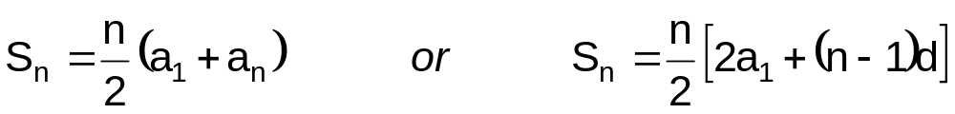
Definition
Sum of the First n Terms of an Arithmetic Sequence
The sum of the first n terms of an arithmetic sequence is given by:

Slide 7
EXAMPLE:
  Find the sum of the positive even integers up to and including 350.
  ans. 30, 800
  For an arithmetic series with a₁= -11, S_{n}= -32 and fourth term is -5, find d and n.
  ans. d = 2; n = 4&8
  3. The balcony of a theater has 12 rows of seats. The last row contains 8 seats, and each of the other rows contains one more seat than the row behind it. How many seats are there in the balcony?
  ans. 162
  4. The sum of the progression 5, 8, 11, 14, … is 1025. How many terms are there?
  ans. 25

Slide 8
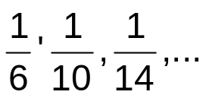

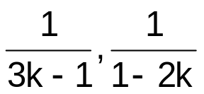
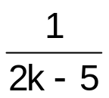

Definition:
HARMONIC SEQUENCE
Harmonic sequence is a sequence formed by the reciprocals of the terms of an arithmetic sequence. The terms between any two terms of a harmonic sequence are called harmonic means. To find the nth term of a harmonic sequence , first write the corresponding arithmetic sequence. Second, determine the nth term of the arithmetic sequence. Lastly, take its reciprocal.
EXAMPLE:
  1.What is the ninth term of the harmonic progression ? ans.
  2. What is the value of k so that the terms and
  form a harmonic sequence?
  ans.

Slide 9
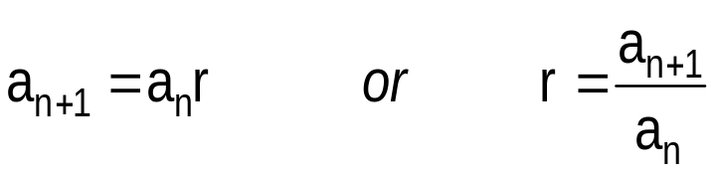

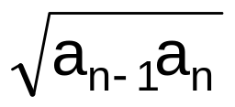
Definition:
GEOMETRIC SEQUENCE
A geometric sequence is a sequence in which the ratio of any two consecutive terms is constant. This constant is called the common ratio, denoted by r.
The nth term of a geometric sequence is given by
A single geometric mean between two numbers is called the geometric mean, or the mean proportional given by

Slide 10
EXAMPLE:
    The third term of a geometric sequence is 32 and the fifth term is 128. Find the first term and the common ratio.
    ans. a₁= 8, r = 2 or -2
  2.What is the mean proportional between 15 and 60?
  ans. 30
  3. The fourth term of a geometric sequence is –10 and the sixth term is -40. What is the ninth term of the sequence?
  ans. -320
    4. KT Airlines’ passenger load has been increasing by 12 % annually. In 2000 they carried 20,500 passengers. How many passengers should they expect to carry in 2010?
  ans. 63,670

Slide 11
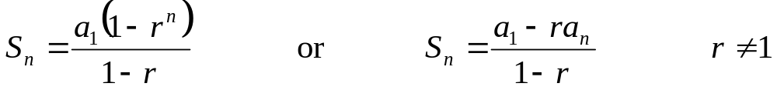


Definition:
Sum of the First nth terms of a Finite Geometric Sequence
The sum of the first nth terms of a finite geometric sequence is given by
EXAMPLE:
  1. If and the common ratio is 2, what is ?
  ans. 504
  2. A piece of paper is 0.05 in thick. Each time the paper is folded into half, the thickness is doubled. If the paper was folded 12 times, how thick in feet the folded paper will be?
  ans. 17.06

Slide 12
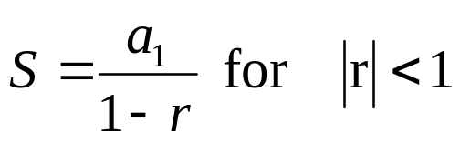

Definition :
Infinite Geometric Series
The sum of a convergent infinite geometric series is given by
EXAMPLE:
    1. Find the sum of the infinite geometric progression 36, 24, 16, …
  ans. 108
    A rubber ball rebounds of its height. If it is initially 30 ft high,
    what total vertical distance does it travel before coming to rest?
  ans. 75

